Slide 1


MICROSOFT STUDIOS FILM RECOMMENDATIONS
Kevin Gross

Slide 2

Agenda
Overview
Primary Goal
Data & Methods
Recommendations
Conclusions
Next Steps

Slide 3

Overview
Microsoft is seeing all the big companies create original video content and have decided this is a revenue stream they want to tap into. Their first thought is to create a new movie studio, but they do not know anything about creating movies.
This presentation explores what types of films perform best at the box office and translates those findings into actionable insights that Microsoft Studios can use to help decide what type of films to create.

Slide 4

PRIMARY GOAL
Use descriptive analysis of movie studio data to give Microsoft 3 concrete business recommendations on how to best approach making films for their new movie studio.

Slide 5




Data & Methods
Movie studio data from 2010 to 2018 was used from 3 resources to better understand why movies perform well at the domestic box office.
Box Office Mojo
Movie Gross Data
The Movie Database
Movie Information
IMDB
Movie Basics & Movie Ratings

Slide 6
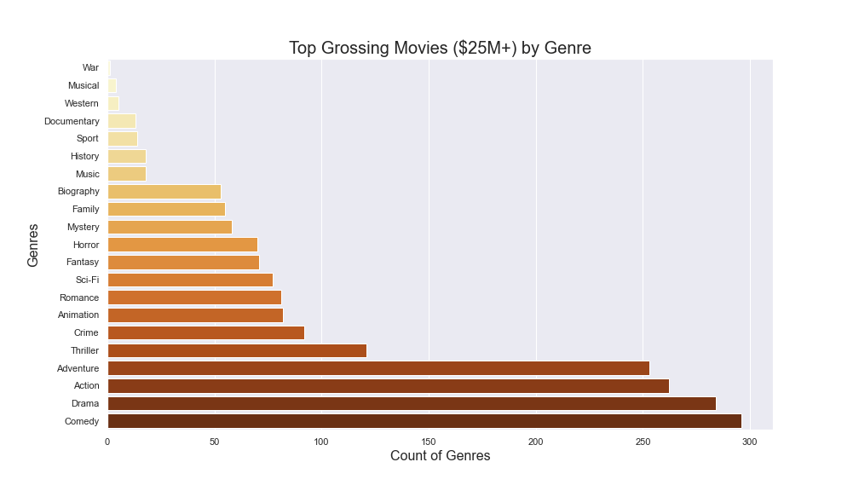
Recommendation #1
Produce movies that are comedy, drama, action or adventure films.
Avoid making movies that are war, musical, or western films.

Slide 7
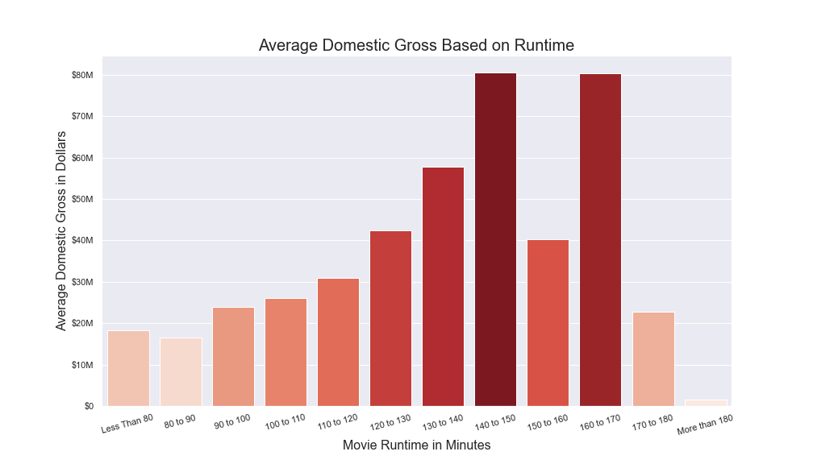
Recommendation #2
Make movies 130 to 170 minutes long.
Avoid making movies that are shorter than 130 minutes and longer than 180 minutes.

Slide 8
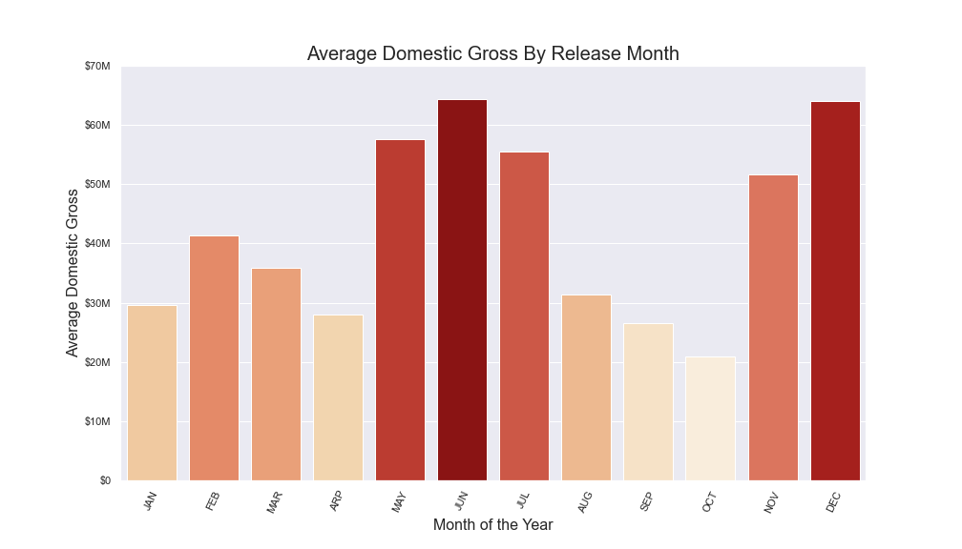
Recommendation #3
Release movies in May, June, July or December.
Avoid releasing films in September and October.

Slide 9

Conclusions
Produce movies that are comedy, drama, action or adventure films.
Make movies 130 to 170 minutes long.
Release movies in May, June, July or December.

Slide 10

Next Steps
ROI
Analyze production budgets for each film and see what genre has the best return on investment based on movie gross.
Marketing
Examine marketing budgets for each film to see where money was spent. Options could include out of home, linear TV advertising, digital advertising, custom content, etc.
Competition
Evaluate the distribution strategy for movies since some films are going straight to home entertainment release rather than an exclusive theatrical window.

Slide 11

Questions?
Kevin Gross
kevgross89@gmail.com
github.com/kevgross89
linkedin.com/in/kevin-gross-312b7340/

